Slide 1

Count_Wood
Project Team Members:
Dhruvi MG 1AY18IS038
Harsh Khare 1AY18IS045
1

Slide 2
Problem Statement
2
As there are many ERP software for usage, but the one having specifications according to the ply world does not exist . Hence the problem is that complex modification has to be made in ERP.
Retail, wholesale, industry levels usage of ERPs in order to maintain a record for their purchases and sales becomes difficult as for a simple transaction becomes complicated.
Few ERP softwares are just meant for either stock management or the transaction management. Therefore the workload of an individual increases in order to maintain the records of transaction and stock separately.

Slide 3
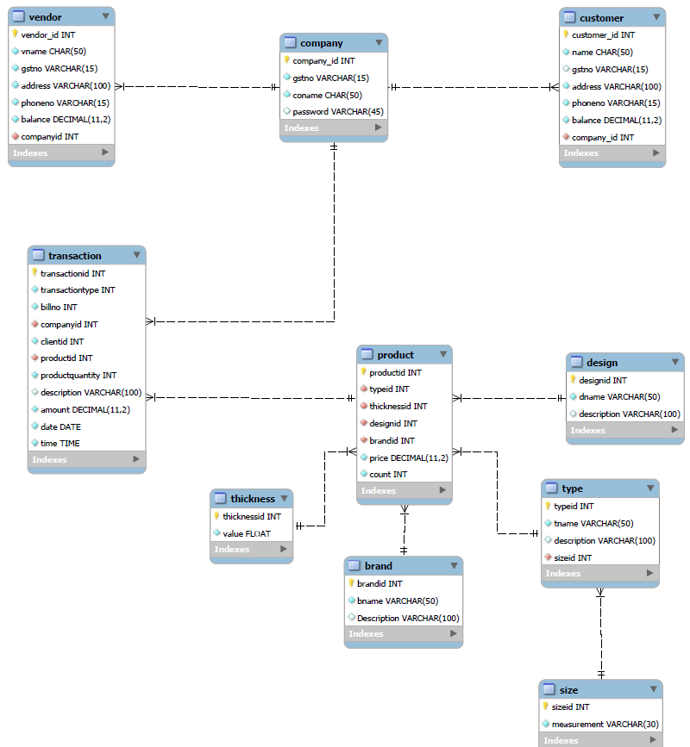
ER Diagram
3

Slide 4
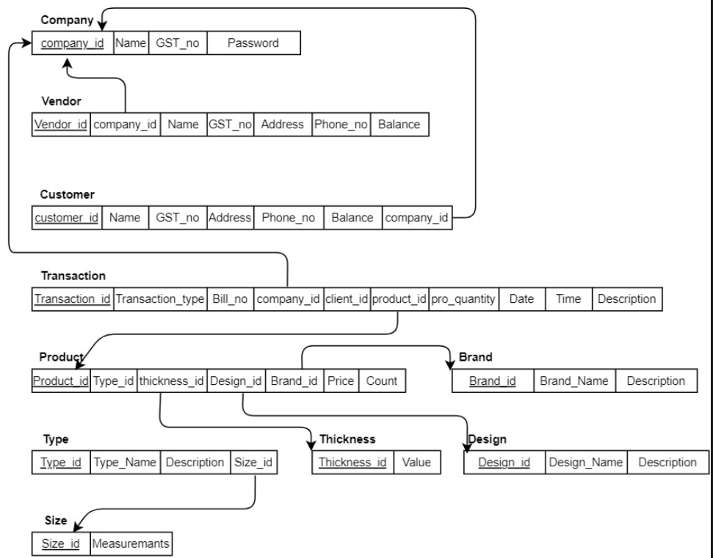
Schema Diagram
4

Slide 5
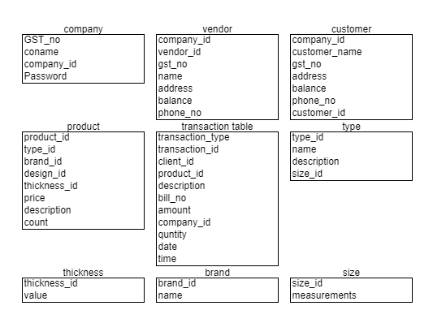
Entities
5

Slide 6
Work done so for
6
The problem statements from the client has been analysed and summarized.
The planning procedure with respect to the given requirements and the functions is covered.
The database tables have been created and the functional queries are in process using MySQL and Java.
With respect to front end the logging in page has been designed , sign up page has been designed using html and css as of now
The test data has been collected from the client in order to test the working of the project.

Slide 7
Stored Procedure & Triggers
7
<Mention at least one Stored Procedure & Triggers for your project>

Slide 8
Applications
8
1) User friendly design.
2) Easy to learn.
3) Provides reports to monitor.
4) Calculates the required dimensions.
5) Maintains stocks of various categories and sizes.
6) Auto-updates the stocks and transactions with respect to invoice.
7) Covers the specifications and saves time.

Slide 9
9

